Slide 1


Michael Lee
November 27, 2022

Slide 2


Outline
Executive Summary
Introduction
Methodology
Results
Conclusion
Appendix

Slide 3
Executive Summary
Summary of Methodologies:
The research attempts to identify the factors for a successful rocket landing. To make this determination, the research used the following methodologies. First, we collected data using SpaceX REST API and web scraping techniques. Second, we wrangled our collected data to create a success/fail outcome variable. Third, we explored our data with visualization techniques, considering factors such as payload, launch site, flight number, and yearly trend. Fourth, we analyzed our data with SQL, calculating such statistics as total payload, the payload range for successful launches, and total number of successful and failure mission outcomes. Fifth, we explored launch site success rates and proximities to geographic markers using an interactive map built with Folium. Sixth, we built a dashboard with Plotly Dash in order to show which launch site had the most success and to examine successful payload ranges. Lastly, we used predictive models – logistic regression, support vector machines (SVM), k-nearest neighbor (KNN), and decision trees – to predict landing outcomes. We found that for our data set that SVM model was the most accurate.
Summary of All Results:
Exploratory data analysis results: The success rate of launches increases over time; KSC LC-39A has the highest success rate among the launch sites; orbits ES-L1, GEO, HEO, and SSO have a 100% success rate.
Interactive analytics demo in screenshots: Most of the launch sites are in proximity to the equator and all of the launch sites are close to the coast.
Predictive analysis results: we found that the SVM is the best predictive model for our dataset.

Slide 4
Introduction
Project background and context
SpaceX, a leading company in the commercial space industry, strives to make space travel more cost effective. The company developed the Falcon 9 rocket, which costs $62 million per launch because of its novel reuse of the first stage; other companies in commercial space travel, which do not reuse the first stage, charge $165 million per launch. Therefore, assuming the first stage can be reused, determining the success of a first-stage landing can determine the cost per launch. We will therefore use public data and machine learning models to predict if SpaceX (or a competing company) can reuse the first stage.
For this project, we will explore answers to the following questions:
How do variables such as payload mass, launch site, number of flights, and orbits affect the success of the first-stage landing?
Does the rate of successful landings increase over time?
What is the best predictive method that can be applied for binary classification?

Slide 5

Section 1

Slide 6
Methodology
Executive Summary
Data collection methodology
Using SpaceX REST API and Web Scraping from Wikipedia
Perform data wrangling
Filtering the data; handling with missing value; applying One Hot Encoding to prepare the data to a binary classification
Perform exploratory data analysis (EDA) using visualization and SQL
Perform interactive visual analytics using Folium and Plotly Dash
Perform predictive analysis using classification models
Building, tuning, and evaluation of classification models to ensure the best results.

Slide 7
Data Collection
The data collection process employed API requests from SpaceX REST API and Web Scraping data from a table in SpaceX’s Wikipedia page.
I used both data collection methods to obtain the needed information on the launches to conduct a more detailed analysis.
I obtained the following data columns using SpaceX REST API:
FlightNumber, Date, BoosterVersion, PayloadMass, Orbit, LaunchSite, Outcome, Flights, GridFins, Reused, Legs, LandingPad, Block, ReusedCount, Serial, Longitude, Latitude.
I obtained the following data columns using Web Scraping:
Flight No., Launch Site, Payload, PayLoadMass, Orbit, Customer, Launch outcome, Version Booster, Booster landing, Date, Time.

Slide 8
Data Collection – SpaceX API
Request rocket launch data from SpaceX API.
Create dictionary from the data.
Create a dataframe from the dictionary.
Request information about the launches from SpaceX API by applying custom functions.
Decode the response using .json() and converting it to a dataframe using .json_normalize().
Filter the dataframe to contain only the Falcon 9 launches.
Export the data to a CSV file.
Replace missing values of Payload Mass with calculated .mean() .
GitHub URL for SpaceX API Notebook

Slide 9
Data Collection – Web Scraping
Request Falcon 9 launch data from Wikipedia.
Collect the data from parsing HTML tables.
Create a dictionary from the data.
Extract all column names from HTML table header.
Create a BeautifulSoup object from HTML response.
Create a dataframe from the dictionary.
Export the data to a CSV file.
GitHub URL for Data Collection with Web Scraping Notebook

Slide 10
Data Wrangling
In the data set, the booster did not always land successfully: a landing could be attempted but could fail because of an accident.
True Ocean meant that the mission outcome had a successful landing to a specific region of the ocean; a False Ocean meant that the mission had an unsuccessful landing to a specific region.
True RTLS meant that the mission outcome had a successful landing on a ground pad; a False RTLS meant that the mission had an unsuccessful landing to a ground pad.
True ASDS meant that the mission outcome had a successful landing on a drone ship; False ASDS meant that the mission had an unsuccessful landing on a drone ship.
We convert those outcomes into training labels with “1” meaning the booster successfully landed, and “0” meaning that the landing was unsuccessful.
Perform exploratory data analysis and determine training labels.
Calculate the number of launches for each site.
Calculate the number and occurrence of each orbit.
Calculate the number and occurrence of mission outcome per orbit type.
Create a landing outcome label from outcome label.
Export the data to a CSV file.
GitHub URL for Data Wrangling Notebook

Slide 11
EDA with Data Visualization
The following charts were plotted: Flight Number versus Payload; Flight Number versus Launch Site; Payload Mass versus Launch Site; Orbit Type versus Success Rate; Flight Number verses Orbit Type; Payload Mass versus Orbit Type; and Success Rate Year Trend.
Scatter plots show the relationship between variables. If a relationship exists, they could be useful in a machine learning model. Bar charts show comparisons among discrete categories. The goal of a bar chart is to show the relationships among the specific categories being compared and a measured value.
GitHub URL for EDA with Data Visualization Notebook

Slide 12
EDA with SQL
SQL Queries Performed:
Displaying the names of the unique launch sites in the space mission.
Displaying 5 records where launch sites begin the string ‘CCA’.
Displaying the total payload mass carried by boosters launched by NASA (CRS).
Displaying the average payload mass carried by booster version F9 v1.1.
Listing the date when the first successful landing outcome in ground pad was achieved.
Listing the names of the boosters which have success in drone ship and have payload mass greater than 4000 but less than 6000.
Listing the total number of successful and failure mission outcomes.
Listing the names of the booster versions which have carried the maximum payload mass.
Listing the failed landing outcomes in drop ship, their booster versions and launch site names for the months in year 2015.
Ranking the count of landing outcomes (such as Failure (drone ship) or Success (ground pad) between the date 2010-06-04 and 2017-03-20 in descending order.
GitHub URL for EDA with SQL Notebook

Slide 13
Build an Interactive Map with Folium
Markers of all Launch Sites:
Added Marker with Circle, Pop-up Label and Text Label of NASA Johnson Space Center using its latitude and longitude coordinates as a start location.
Added Markers with Circle, Popup Label and Text Label of all Launch Sites using their latitude and longitude coordinates to show their geographical locations and proximity to the Equator and coasts.
Colored markers of the launch outcomes for each Launch Site:
Added colored markers of success (green) and failed (red) launches using Marker Cluster to identify which launch sites have relatively high success rates.
Distances between a Launch Site to its proximities:
Added colored lines to show distances between the Launch Site CCAFS SLC-40, as an example, and its proximity to the nearest railway, highway, coastline, and closest city.
GitHub URL for Interactive Map with Folium (pdf of Notebook) [1]

Slide 14
Build a Dashboard with Plotly Dash
Launch Sites Dropdown List:
Added a dropdown list to enable Launch Site selection.
Pie Chart showing Successful Launches (All Sites/Certain Site):
Added a pie to show the total successful launches count for all sites and the success versus failed counts for the site, if a specific Launch Site was selected.
Slider of Payload Mass Range:
Added a slider to select Payload range.
Scatter Chart of Payload Mass versus Success Rate for the different Booster Versions:
Added a scatter chart to show the correlation between Payload and Launch Success.
GitHub URL for Plotly Dash App [2]

Slide 15
Predictive Analysis (Classification)
Create a NumPy array from the column “Class” in data.
Create a GridSearchCV object with cv=10 to find the best parameters.
Apply the GridSearchCV on LogReg, SVM, Decision Tree, and KNN models.
Split the data into training and test data sets with train_test_split function.
Standardize the data with StandardScaler and then fit and transform the data.
Calculate the accuracy on the test data using the method .score() for all models.
Identify the best model by reviewing the Jaccard_score and F1_score results.
Assess the confusion matrix for all models.
GitHub URL for Machine Learning Prediction Lab

Slide 16
Results
Sections 2, 3, 4, and 5 will present the results of this research in more detail, but we summarize some of our results below:
Exploratory data analysis results:
The success rate of launches increases over time.
KSC LC-39A has the highest success rate among the launch sites.
Orbits ES-L1, GEO, HEO, and SSO have a 100% success rate.
Interactive analytics demo in screenshots: Most of the launch sites are in proximity to the equator and all of the launch sites are close to the coast.
Predictive analysis results: we found that SVM is the best predictive model for the dataset

Slide 17

Section 2

Slide 18
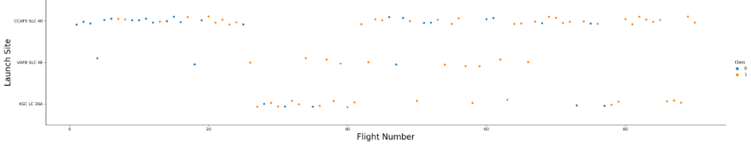
Flight Number versus Launch Site
Explanation:
The earliest flights tended to fail while the latest flights tended to succeed.
The CCAFS SLC 40 launch comprises about half of the launches.
VAFB SLC 4E and KSC LC 39A have higher success rates.
From the plot, we can infer that new launches have a higher success rate.

Slide 19
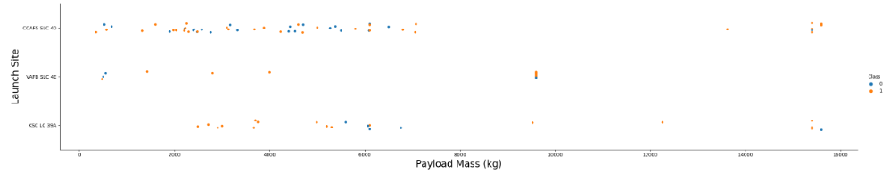
Payload versus Launch Site
Explanation:
For every launch site, the higher the payload mass, the higher the success rate.
Most of the launches with payload mass over 7000 kg were successful.
KSC LC 39A has a 100% success rate for payload mass under 5500 kg too.

Slide 20
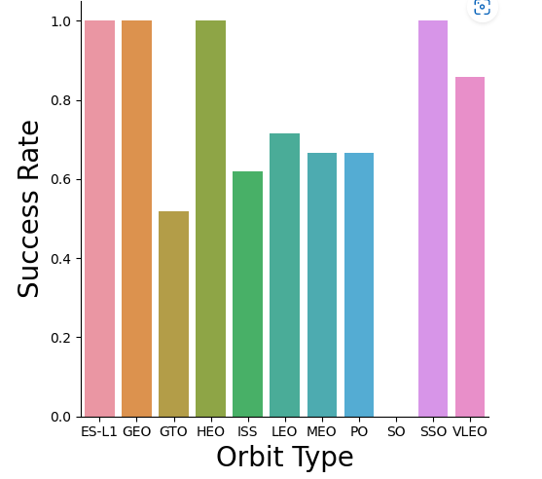
Success Rate versus Orbit Type
Explanation:
Orbits with 100% success rate: ES-LI, GEO, HEO, SSO
Orbits with 0% success rate: SO
Orbits with a success rate between 50% and 85%: GTO, ISS, LEO, MEO, PO

Slide 21
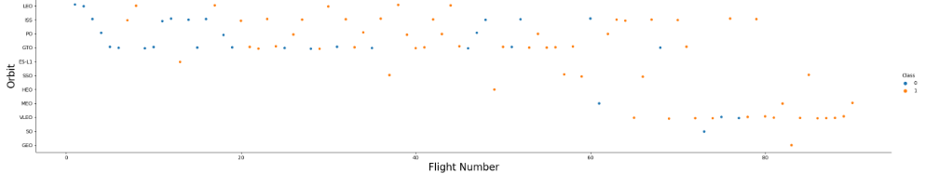
Flight Number versus Orbit Type
Explanation: In the LEO orbit, success appears to be related to the number of flights. However, this relationship disappears when in GTO orbit.

Slide 22
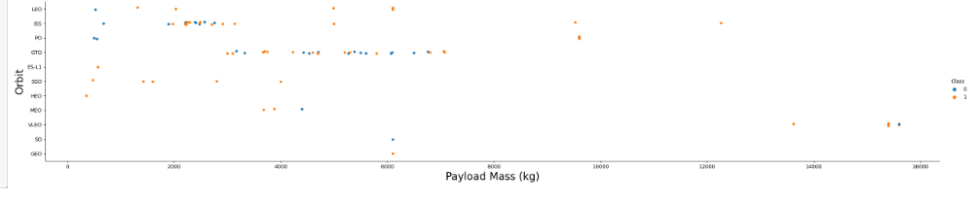
Payload Mass versus Orbit Type
Explanation: Heavy payloads have a negative influence on GTO orbits and positive influences on GTO and Polar LEO (ISS) orbits.

Slide 23
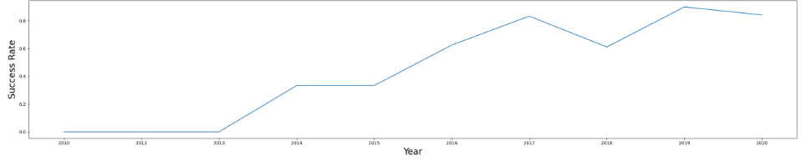
Launch Success Yearly Trend
Explanation: The success rate increased from 2013 to 2020.

Slide 24
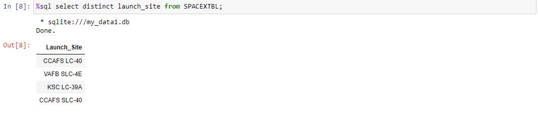
All Launch Site Names
Explanation: The names of the unique launch sites in the space mission are displayed above.

Slide 25
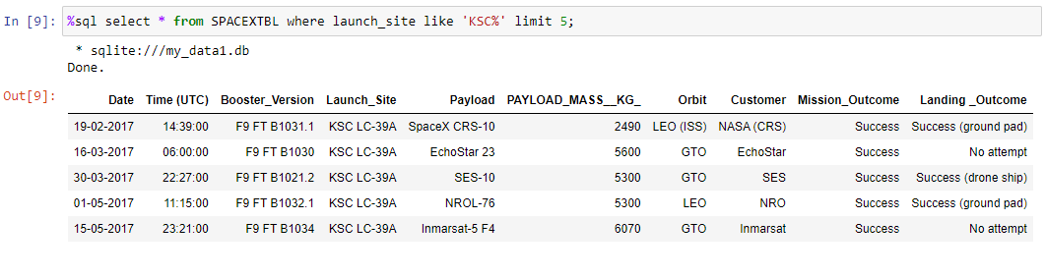
Launch Site Names Begin with 'KSC'
Explanation: Displaying the 5 records where the launch site being the string ‘KSC’.

Slide 26
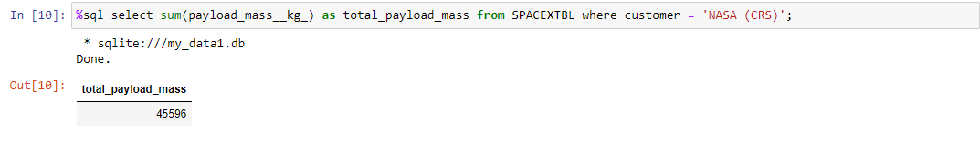
Total Payload Mass
Explanation: The total payload mass carried by the boosters launched by NASA is 45,596 kg and is displayed above.

Slide 27
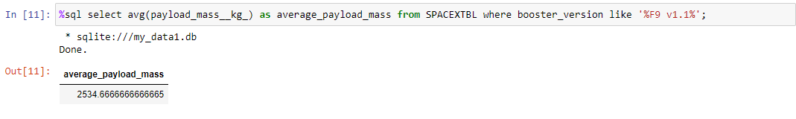
Average Payload Mass by F9 v1.1
Explanation: The average payload mass carried by booster version F9 v1.1 is 2,534.67 kg and is displayed above.

Slide 28
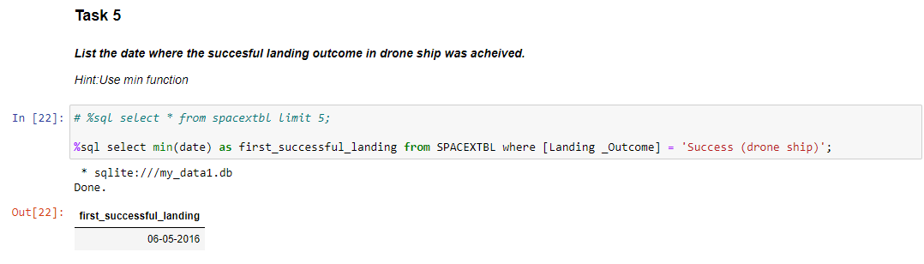
First Successful Drone Ship Landing Date
Explanation: The date of the first successful landing outcome in the drone ship is displayed above. [3]

Slide 29
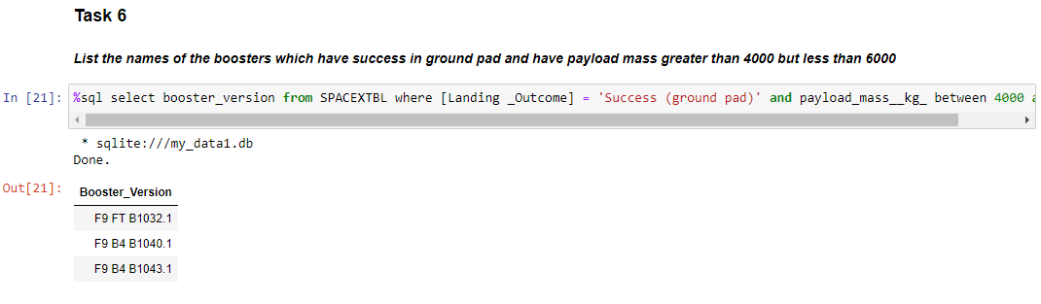
Successful Ground Pad Landings with Payload between 4000 kg and 6000 kg
Explanation: The names of the boosters with successful ground pad landings and have a payload mass greater than 4000 kg but less than 6000 kg are displayed above. [4]

Slide 30
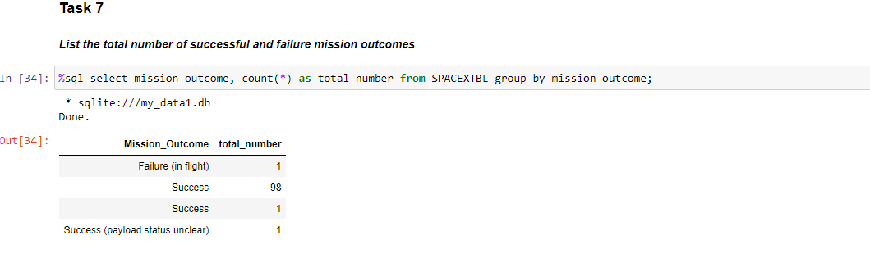
Total Number of Successful and Failure Mission Outcomes
Explanation: The total number of successful and failure mission outcomes are listed above.

Slide 31
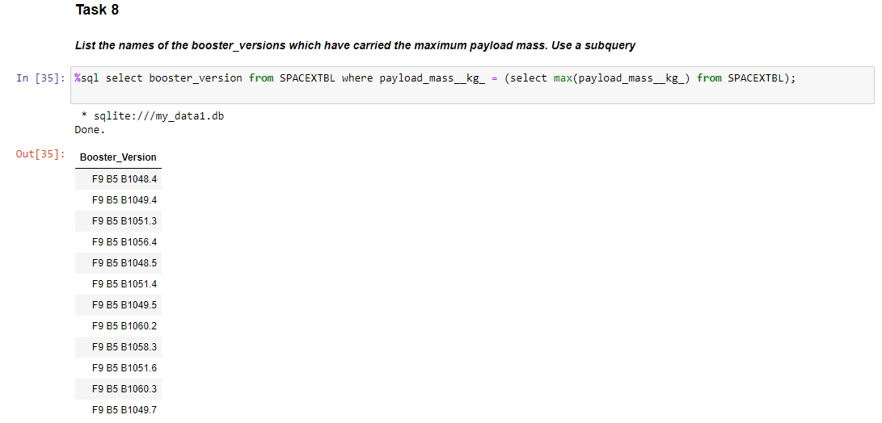
Boosters Carried Maximum Payload
Explanation: The names of booster versions which have carried the maximum payload mass are displayed above.

Slide 32
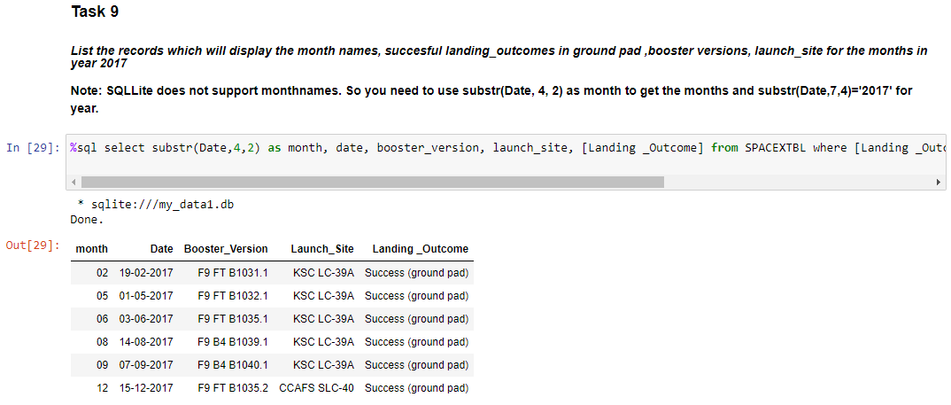
2017 Launch Records
Explanation: The successful ground pad landing outcomes, their booster versions, and launch site names for the month in year 2017 are listed above. [5]

Slide 33
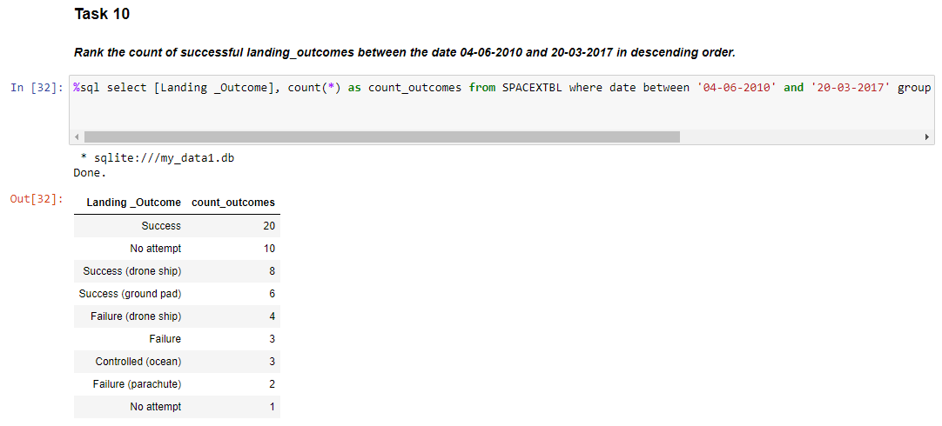
Rank Landing Outcomes Between 2010-06-04 and 2017-03-20
Explanation: Ranking the count of landing outcomes between 2010-06-04 and 2017-03-20 in descending order.

Slide 34

Section 3

Slide 35
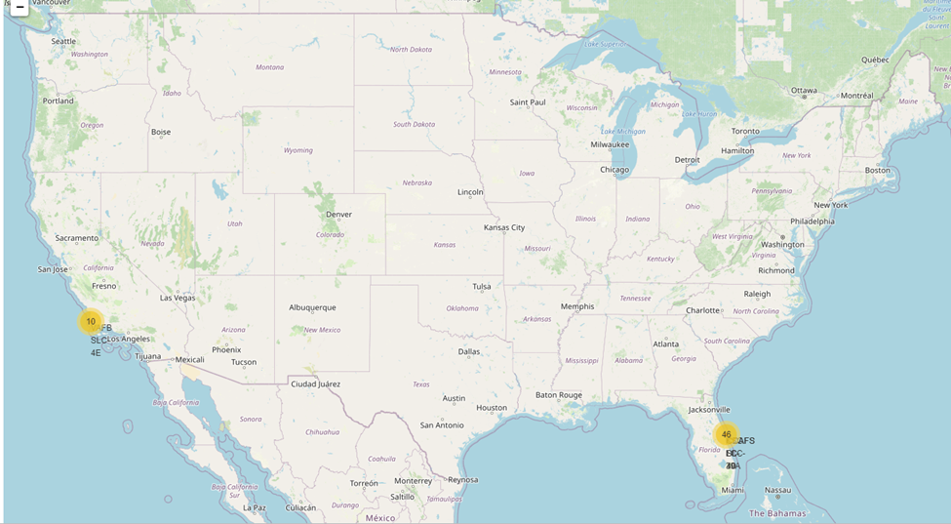
Launch Site Location Markers on a US Map
Explanation:
Most of the launch sites are close to the equator. This is because the Earth is rotating faster at the equator (approximately 1670 km/hour) than at other latitudes. This high rotational velocity will help a rocket launched near the equator achieve and stay in orbit.
All launch sites are near the coast to minimize the risk of debris damaging people or property in the event of a mission failure.

Slide 36
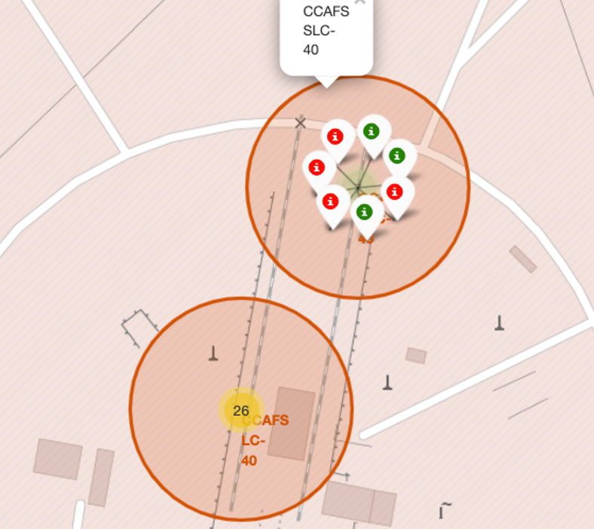
Color-Labeled Launch Outcomes on the Map
Explanation:
Using the color-labeled markers, we can identify which launch sites have relatively high success rates, with green marker indicating successful launch and red marker indicating a failed launch.
Launch site CCAFS SLC-40 has a relatively low success rate (3/7 or 42.9%).

Slide 37
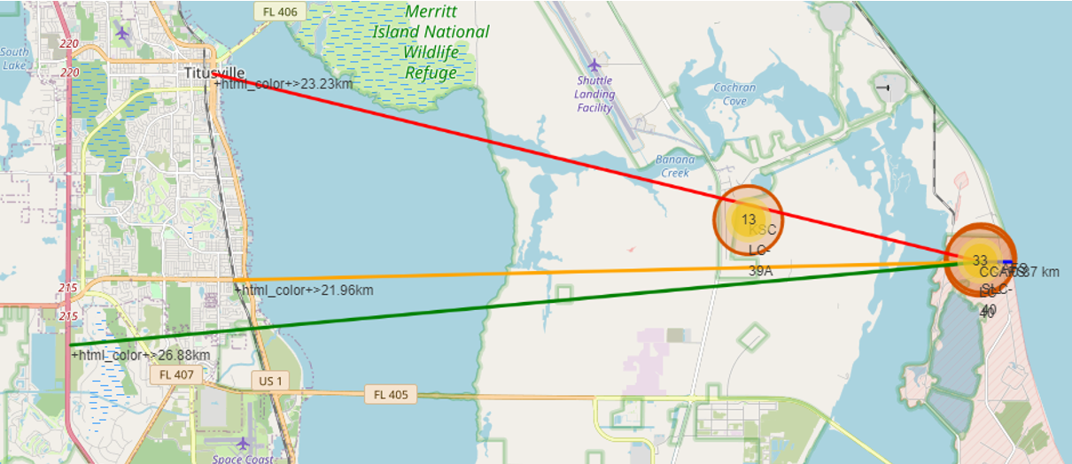
Distance from CCAFS SLC-40 to Proximities
Explanation:
From visual analysis of CCAFS SLC-40, we see that it is:
21.96 km from the nearest railway
26.88 km from the nearest highway
0.866 km from the nearest coastline
23.23 from the nearest city
A failed rocket can cover distances such as 15 to 20 kilometers in a few seconds, making them potentially dangerous in densely populated areas.

Slide 38

Section 4

Slide 39
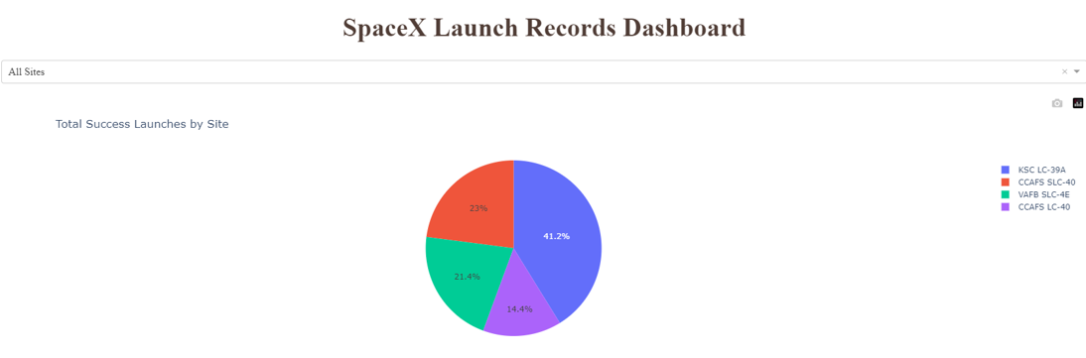
Launch Success Count for All Sites
Explanation: The pie chart shows that KSC LC-39A has the most successful launches among the launch sites.

Slide 40
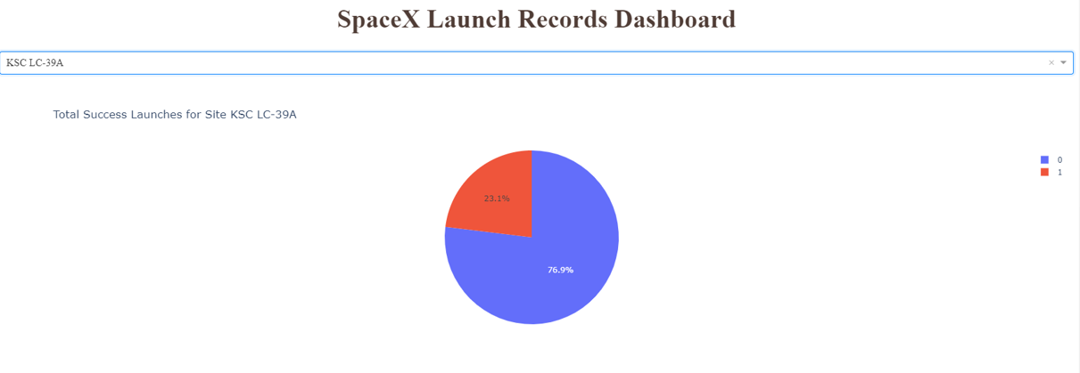
Launch Site with the Highest Launch Success Ratio
Explanation: KSC LC-39A has the highest launch success rate (76.9%) with 10 successful and 3 failed launches.

Slide 41
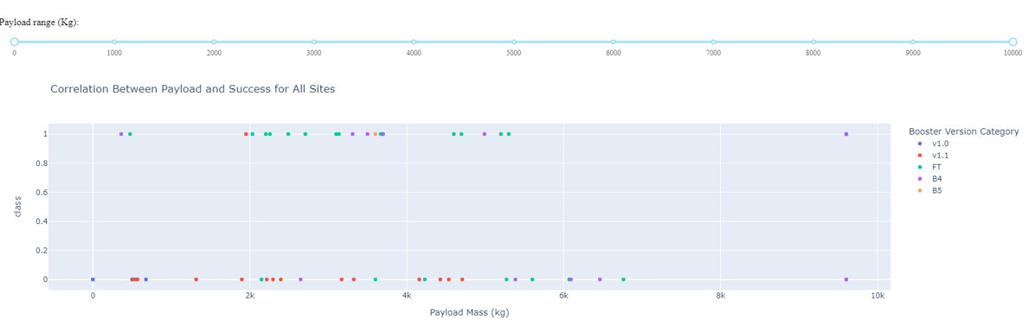
Payload Mass versus Launch Outcome for All Sites
Explanation: The chart shows that payloads between 2000 kg and 5000 kg have the highest success rate.

Slide 42

Section 5

Slide 43
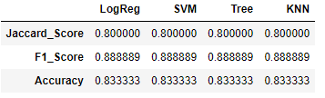
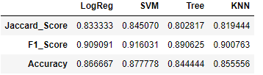
Classification Accuracy
Explanation:
Based on the scores of the test set, we cannot identify which model performed best, as all four models had the same scores and accuracy. This may be due to the small dataset used.
When using the entire dataset, the best model is the SVM, which had highest scores and the highest accuracy.
Scores and Accuracy of the Test Set
Scores and Accuracy of the Entire Data Set

Slide 44
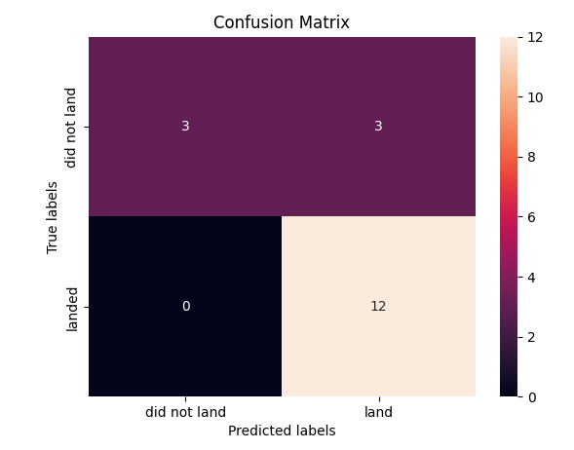
Confusion Matrix
Explanation:
As shown in the confusion matrix of the SVM, the most accurate model, distinctions can be made among the different outcomes. However, this model has some difficulty with false positives.

Slide 45
Conclusion
Our initial research gave us some results to apply to future research:
SVM is the best predictive model for the dataset.
Most of the launch sites are in proximity to the equator and all of the launch sites are close to the coast.
The success rate of launches increases over time.
KSC LC-39A has the highest success rate among the launch sites.
Orbits ES-L1, GEO, HEO, and SSO have a 100% success rate.
For future research, we can build upon our initial results by employing a larger data set and apply the SVM model and other success factors to those data. We can then determine if the same observations that we made in this initial study are generalizable to a larger scale data set. Also, we can see if our results can be replicated by other data scientists, which would aid in our research into booster rocket technology and their cost effectiveness.

Slide 46
Appendix
Endnotes:
[1] I linked the pdf version of the Interactive Map with Folium Notebook because more of the Notebook could be viewed in the pdf version (due to GitHub’s limitations in supporting Folium maps). The link to actual Interactive Map with Folium is here: GitHub link for Interactive Map with Folium Notebook.
[2] Because the lab for Plotly Dash was not conducted in Jupyter Lab, I could not save the notebook. Therefore, I made the link to the Python code used for the lab.
[3] On page 28, I show the first successful drone ship landing since it was required to do during the lab. The template had “First Successful Ground Landing Date,” which I did not follow.
[4] On page 29, I show the successful ground pad landings with payload between 4000 kg and 6000 kg since it was required to do during the lab. The template had “Successful Drone Ship Landing with Payload between 4000 and 6000.”
[5] On page 32, I queried 2017 launch records since that was what was required in the lab. The template had “2015 Launch Records” in the heading.

Slide 47


